Slide 2
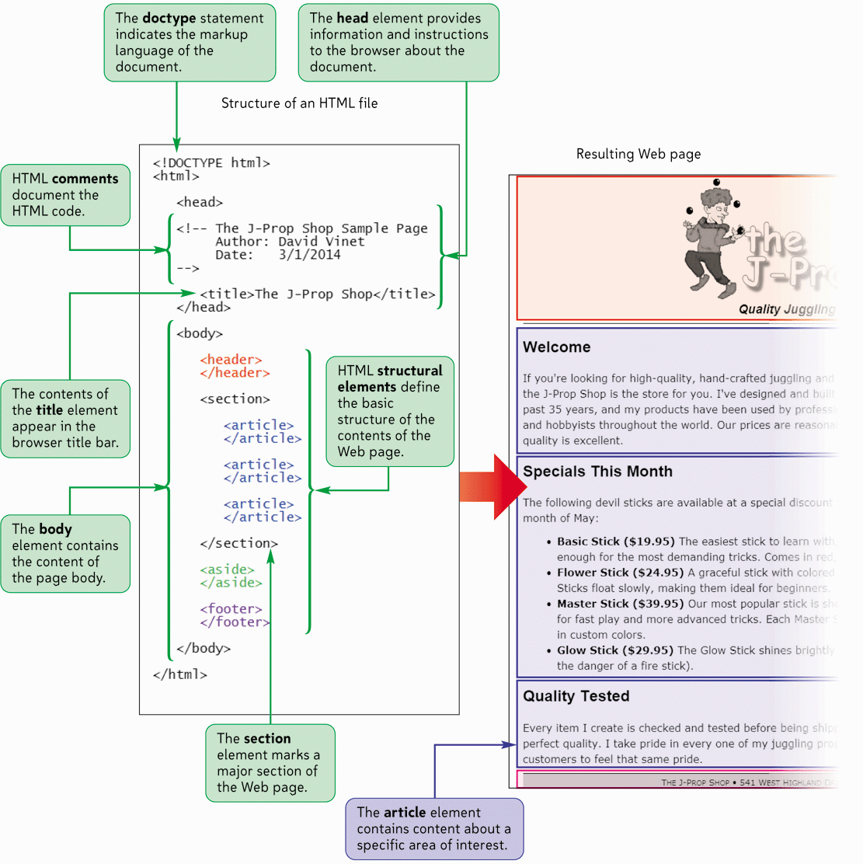
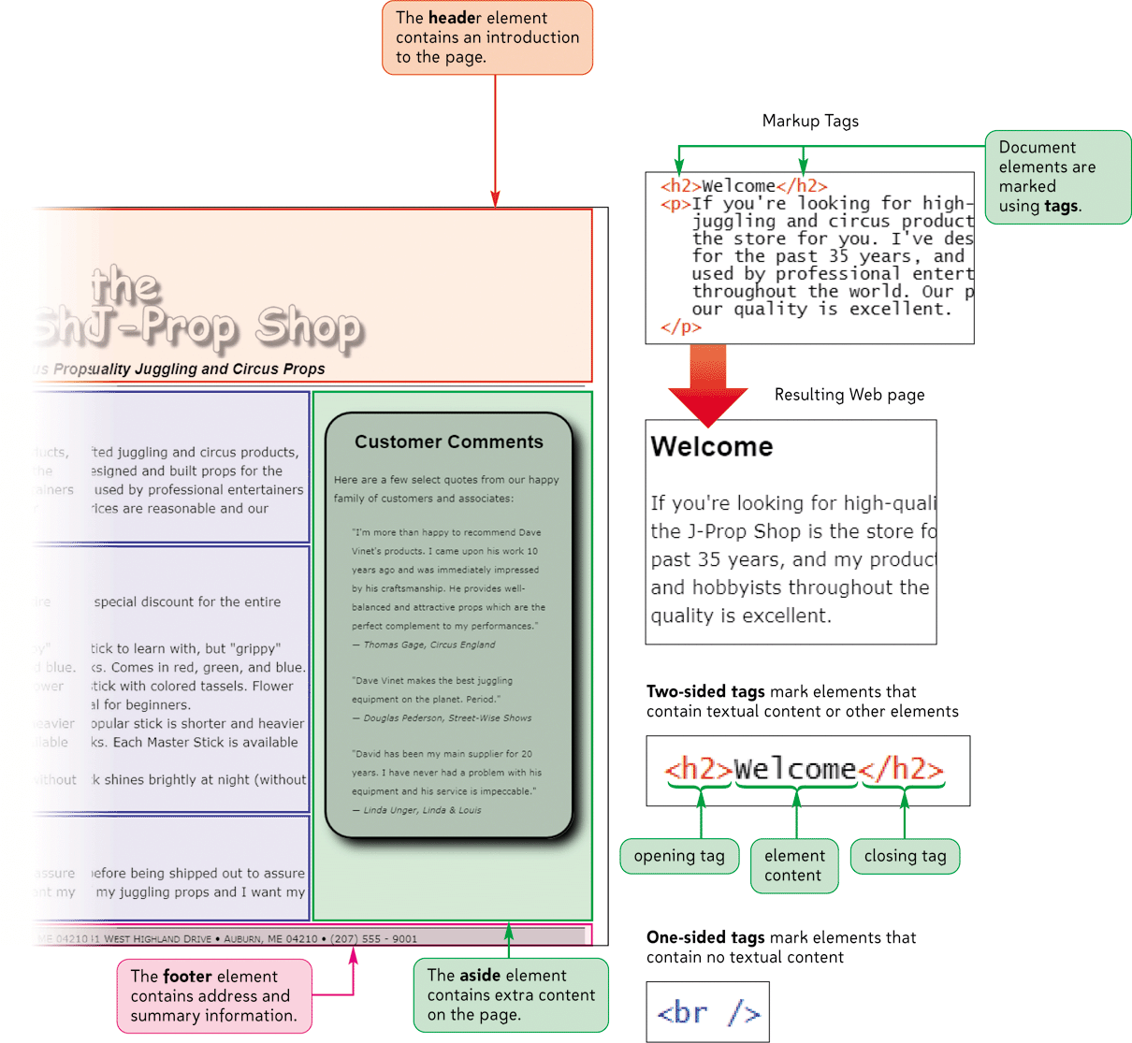
The Structure of an HTML5 Document

Slide 3
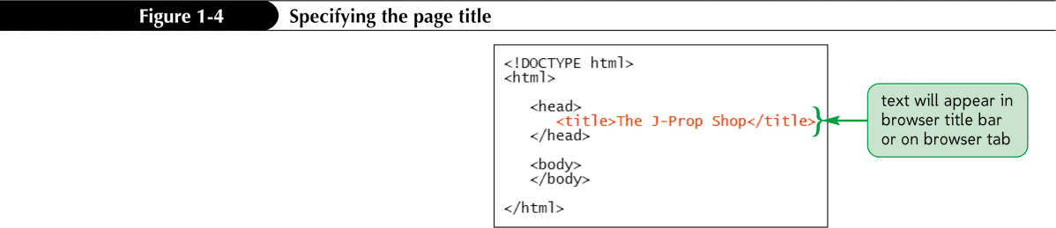
Defining the Page Title

Slide 4
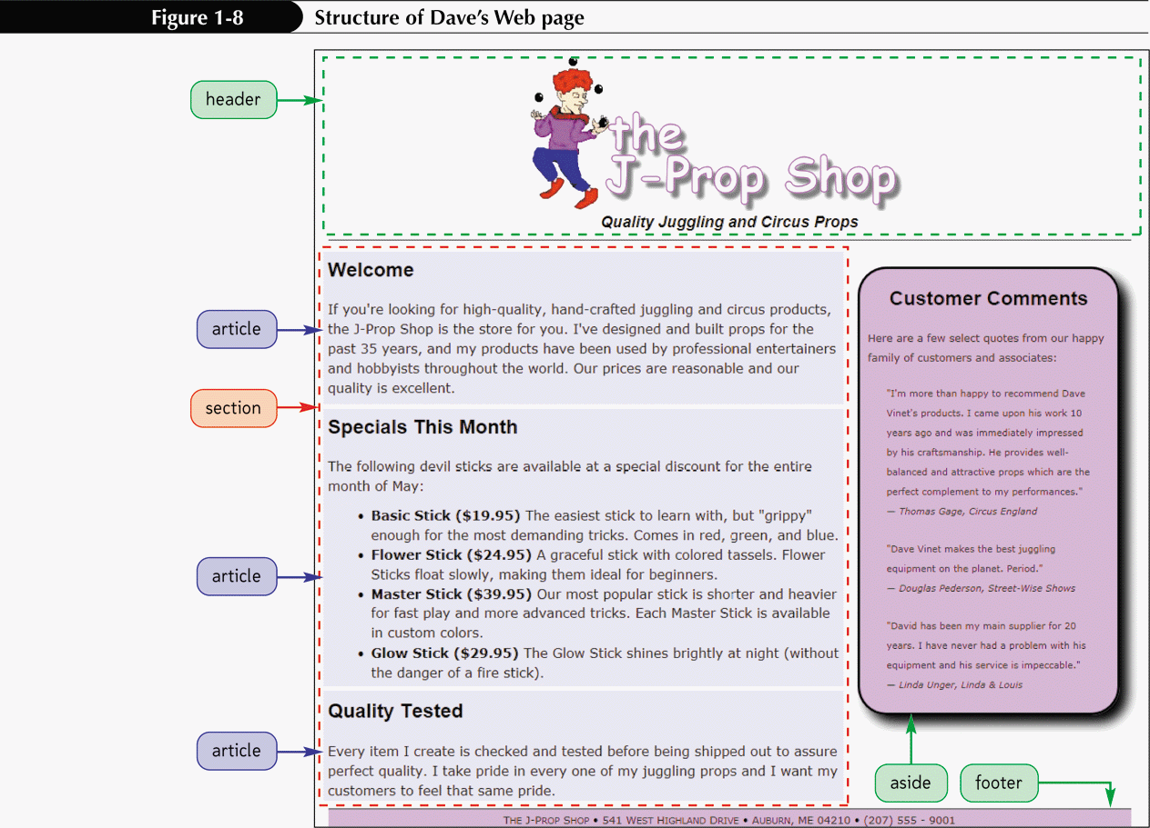
Defining the Structure of the Page Body

Slide 5
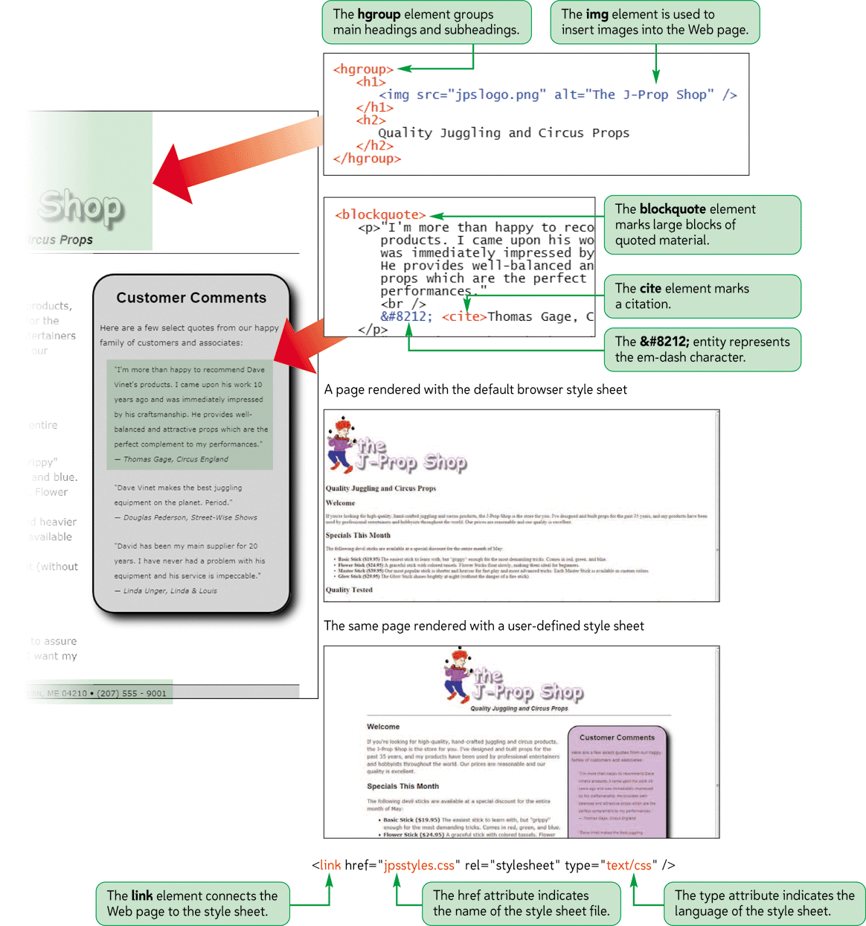
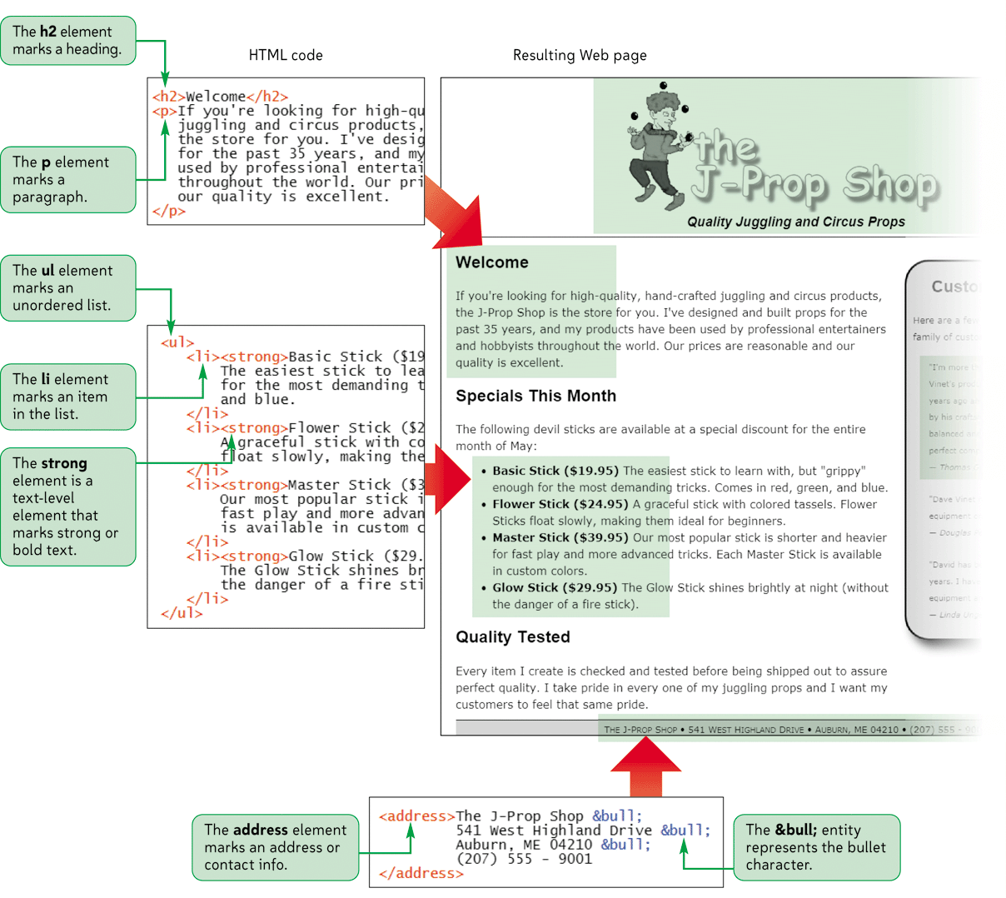
Page Content Elements

Slide 6
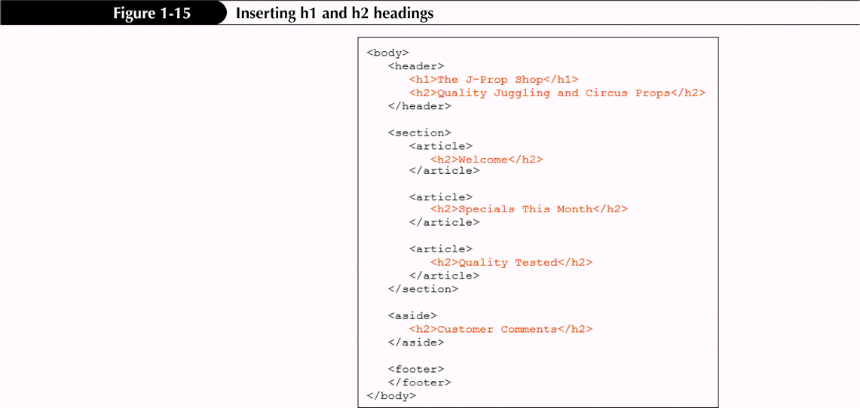
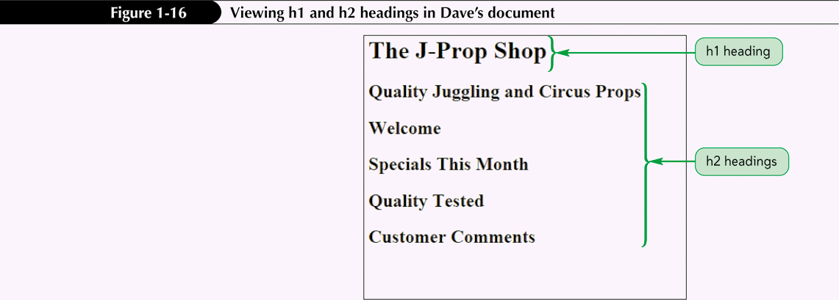
Adding Headings

Slide 7
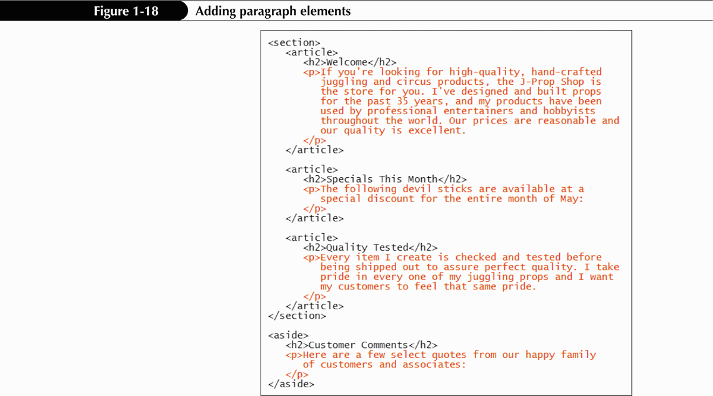
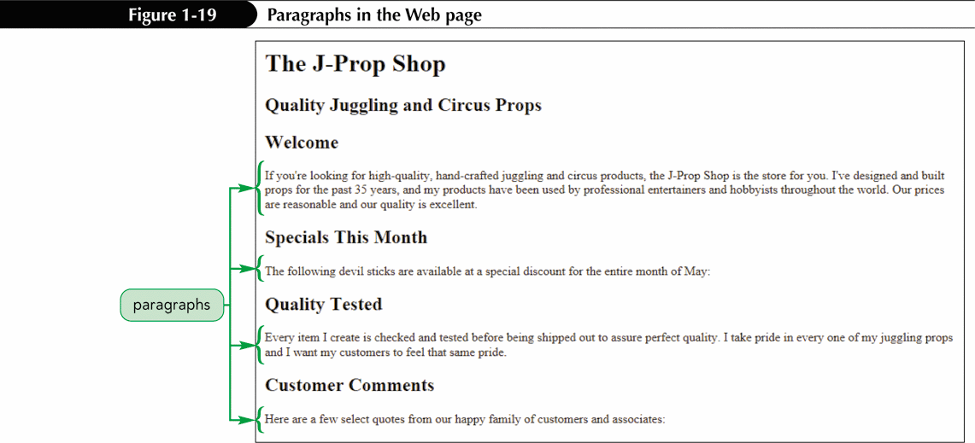
Marking Paragraph Elements

Slide 8
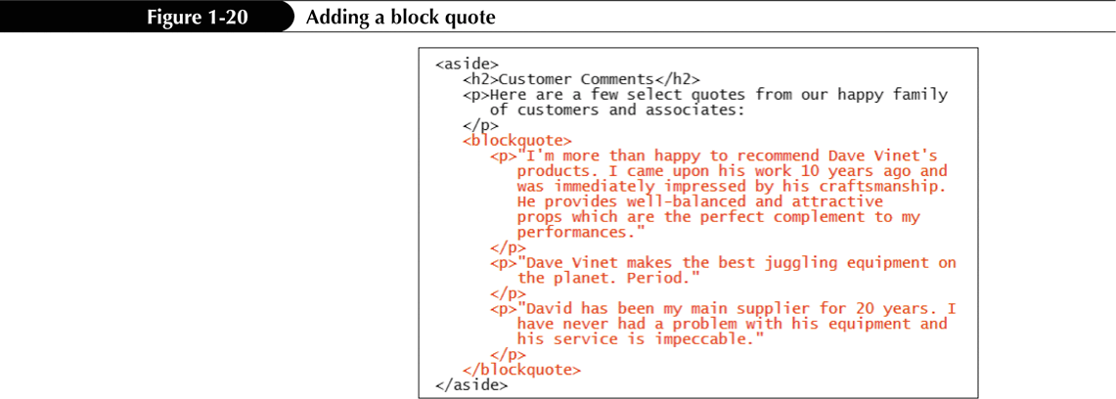
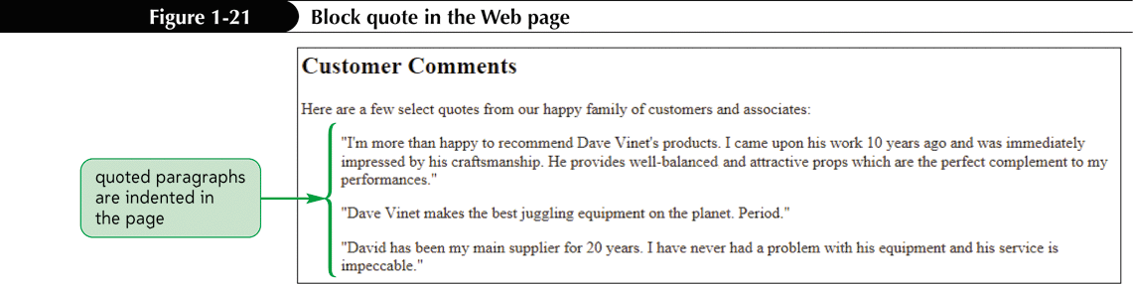
Marking a Block Quote
The syntax for making an extended quote is
<blockquote>content</blockquote>

Slide 9
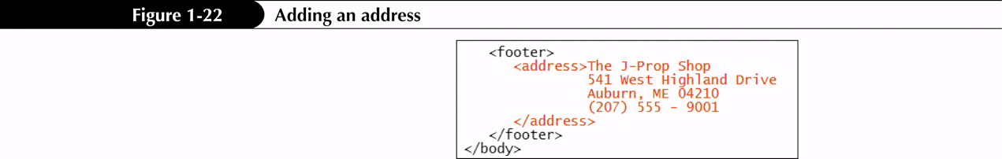
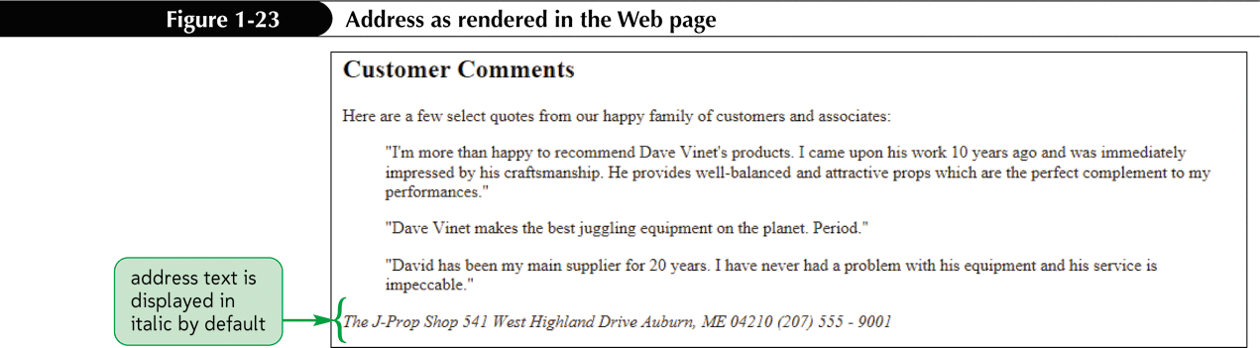
Marking an Address
<address>content</address>

Slide 10
Applying an External Style Sheet
Style sheets are written in the Cascading Style Sheet (CSS) language
To apply an external style sheet to a Web page, you create a link within the document head to the style sheet file using the link element
<link href=”file” rel=”stylesheet” type=”text/css”>

Slide 11
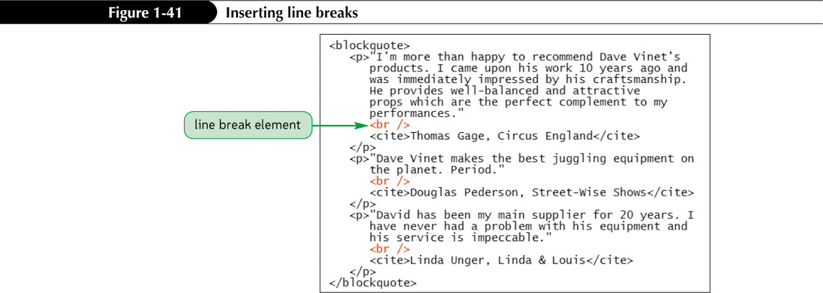
Marking a Line Break

Slide 12
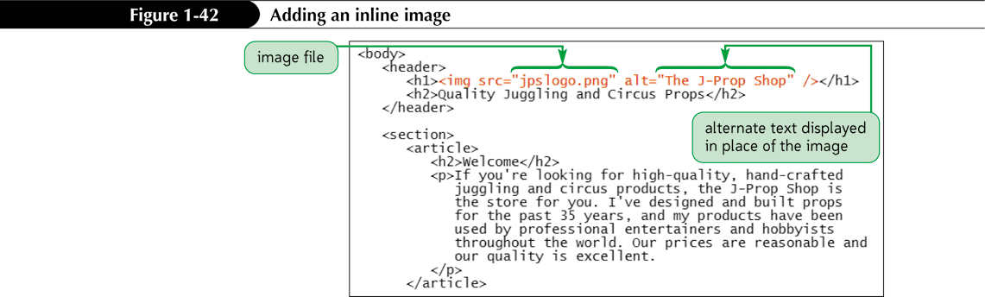
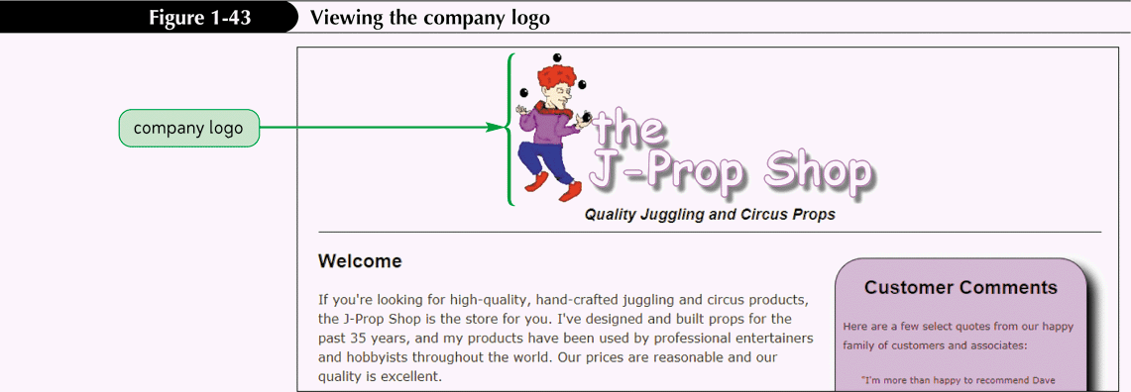
Inserting an Inline Image

